Slide 1
Reformed MOSA for Ground Combat Vehicles
Macam Dattathreya, PhD
DISTRIBUTION STATEMENT A.
Approved for public release; distribution is unlimited. OPSEC # OPSEC-2026-352

Slide 2
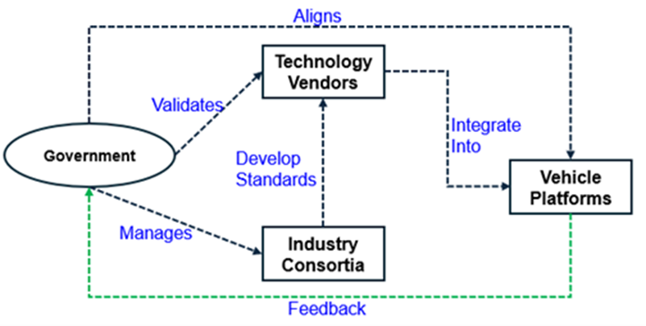
Why Reformed MOSA, Why Now?
Combat vehicles outlive any single technology wave.
Old model: government as system architect and bottleneck.
New model: government as ecosystem governor.
Objective: rapid, multi-vendor upgrades at portfolio scale.
Align vendors and consortia via standards, data, and incentives.
DISTRIBUTION STATEMENT A.
Approved for public release; distribution is unlimited. OPSEC # OPSEC-2026-352

Slide 3
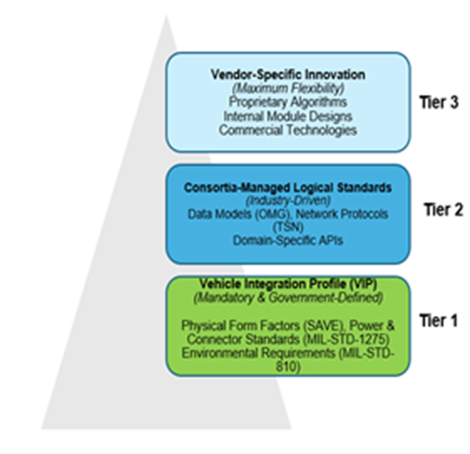
Pillars 1-2: Tiered Standards for Modularity
Separates platform specifics from reusable standards and differentiated products.
DISTRIBUTION STATEMENT A. Approved for public release; distribution is unlimited. OPSEC # OPSEC-2026-352

Slide 4
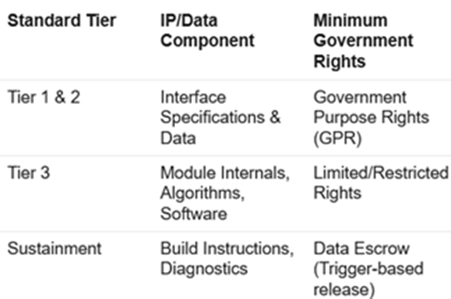
Pillar 3: IP and Data Rights that Enable Reuse
Makes IP a controllable design variable instead of a hidden constraint.
DISTRIBUTION STATEMENT A. Approved for public release; distribution is unlimited. OPSEC # OPSEC-2026-352

Slide 5
Pillar 4: Portfolio Governance and AI Stress Test
Portfolio Acquisition Executive (PAE) owns cross-platform roadmap.
Incentives for module reuse and multi-program adoption.
AI modules stress-test MOSA: high compute, data, and update tempo.
If AI can be swapped between vendors, the ecosystem is working.
DISTRIBUTION STATEMENT A. Approved for public release; distribution is unlimited. OPSEC # OPSEC-2026-352

Slide 6
PAE - Call for Action
Establish clear Vehicle Integration Profiles (VIPs) for physical integration.
Invest in the digital infrastructure for a validation pipeline.
Engage strategically with industry consortia.
Mandate explicit IP negotiations and enterprise-level incentives..
DISTRIBUTION STATEMENT A. Approved for public release; distribution is unlimited. OPSEC # OPSEC-2026-352

